Slide 1
MT104 – LINEAR ALGEBRA
Course Instructor:
Osama Bin Ajaz
Lecturer at FAST – NUCES,
Main Campus, Karachi.

Slide 2
DETERMINANTS (Cofactor Expansion, Row Reduction, Cramer’s Rule)

Slide 3
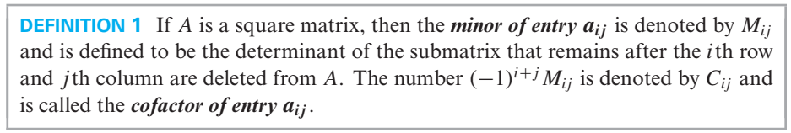
Determinants by Cofactor Expansion

Slide 4
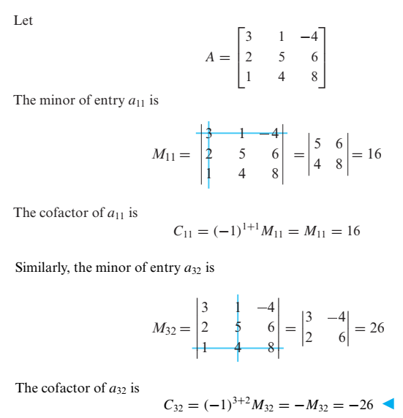
Example # 01 (Finding Minors & Cofactors)

Slide 5
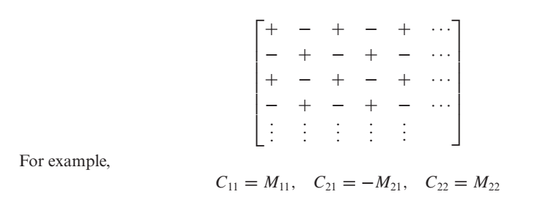
Checkerboard Array

Slide 6
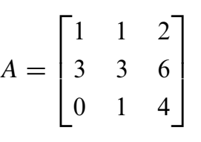
Example: Find all minors and cofactors:
Notes:
Det(A) = 0

Slide 7
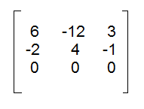

Slide 8
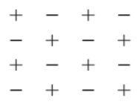
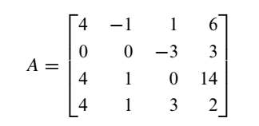
Example: Find all cofactors
Notes:
Det = -216

Slide 9
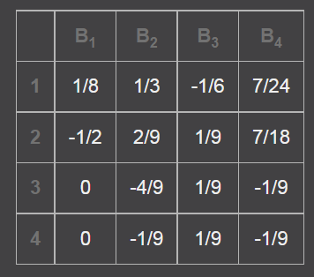

Slide 10
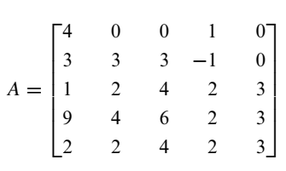
Example: evaluate det(A) by a cofactor expansion
along a row or column of your choice

Slide 11


Slide 12
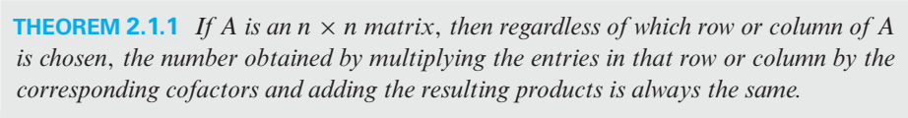
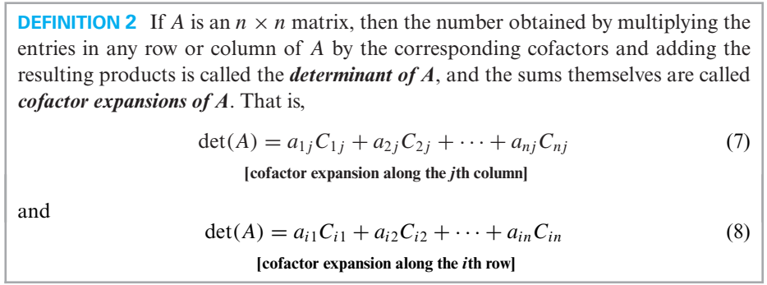

Slide 13
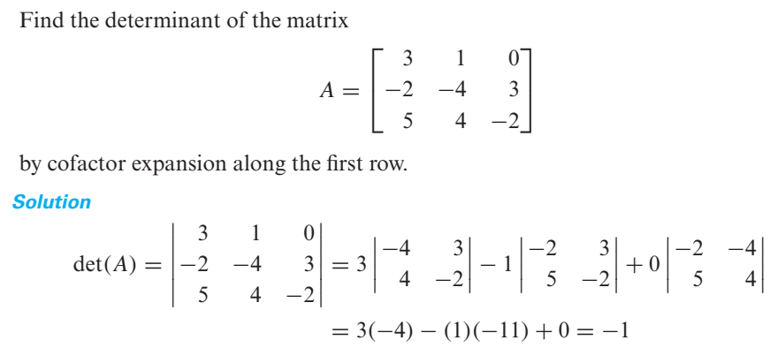
Example # 02 (Cofactor expansion along the first row)

Slide 14
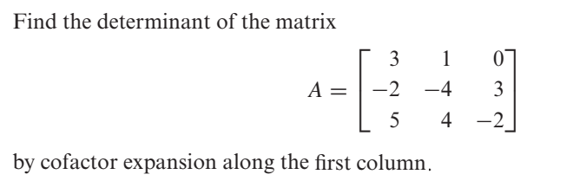
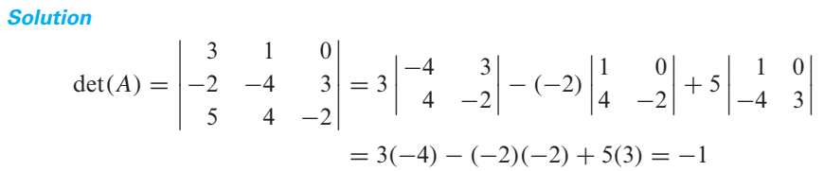
Example # 03 (Cofactor expansion along the first column)
Now see previous slide.

Slide 15
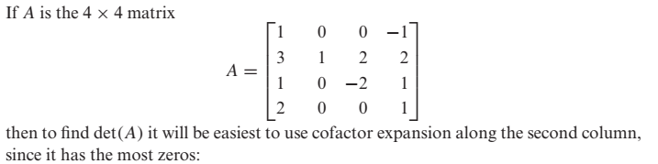
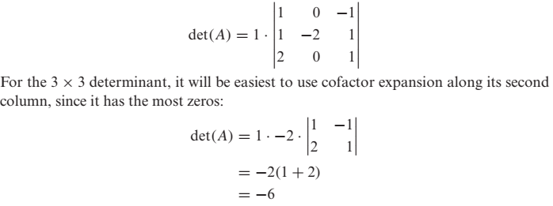
Example # 4 (Smart Choice of Row or Column)

Slide 16
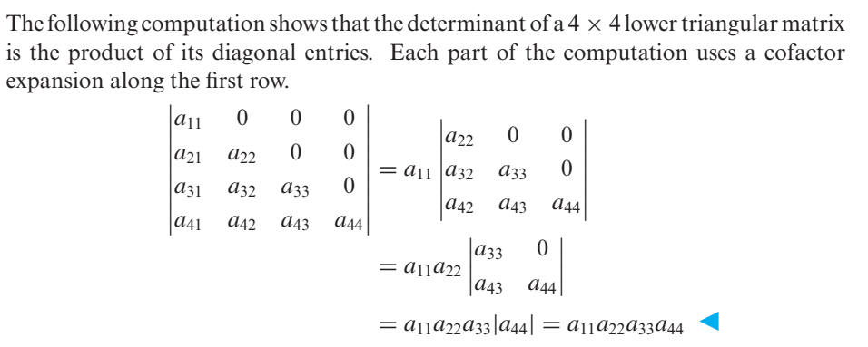
Example # 05 (Determinant of a lower triangular matrix)

Slide 17
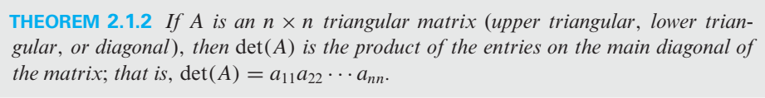

Slide 18
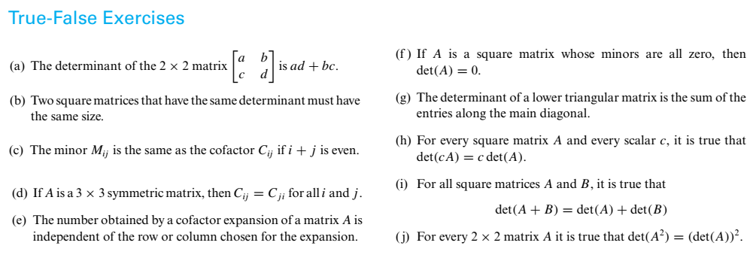
True-False Exercises
TRUE
FALSE
FALSE
FALSE
TRUE
FALSE
FALSE
TRUE
TRUE
TRUE

Slide 19
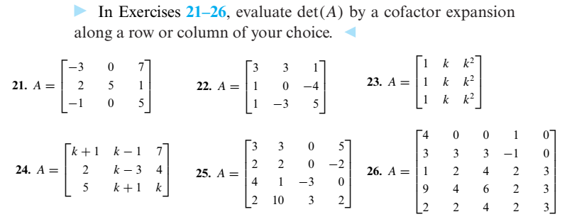
Exercise Set 2.1:

Slide 20
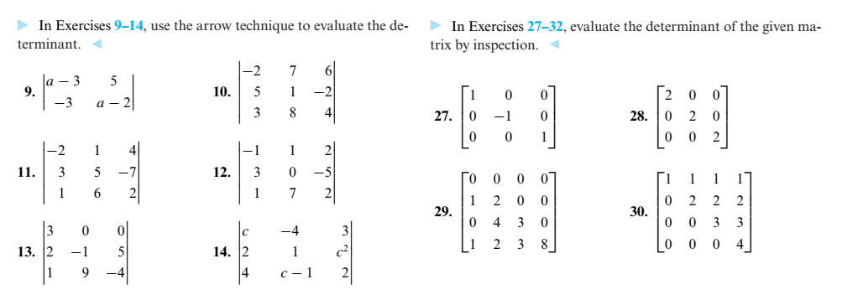
Exercise Set 2.1 (contd.)

Slide 21
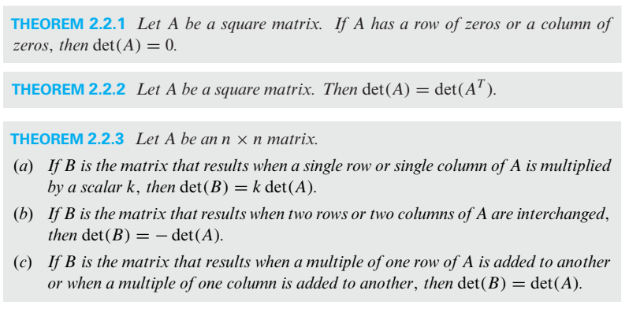
Evaluating Determinants by Row Reduction

Slide 22
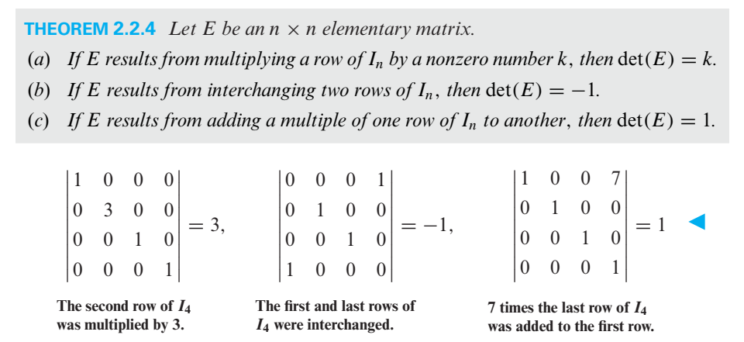
Determinants of Elementary matrices

Slide 23
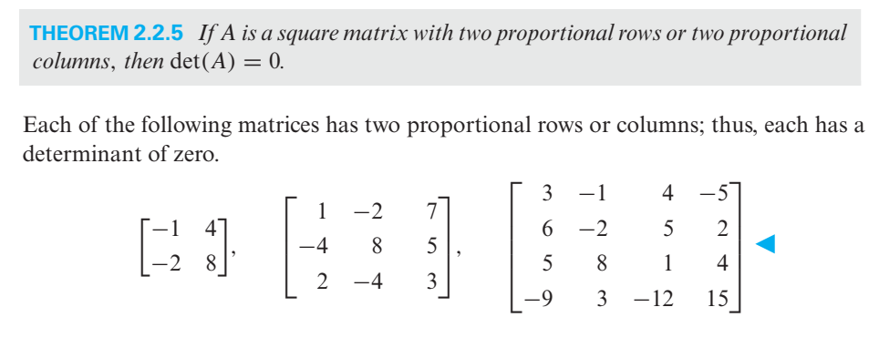
Matrices with proportional rows or proportional columns

Slide 24
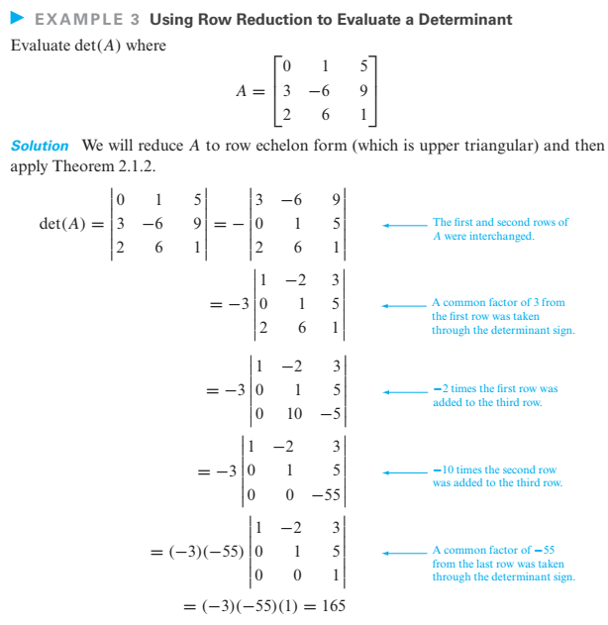

Slide 25
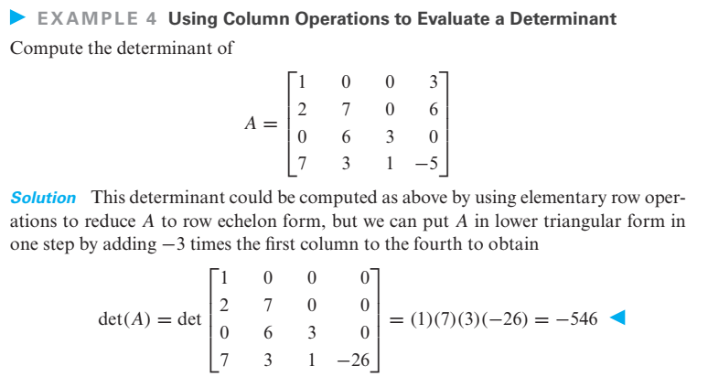

Slide 26
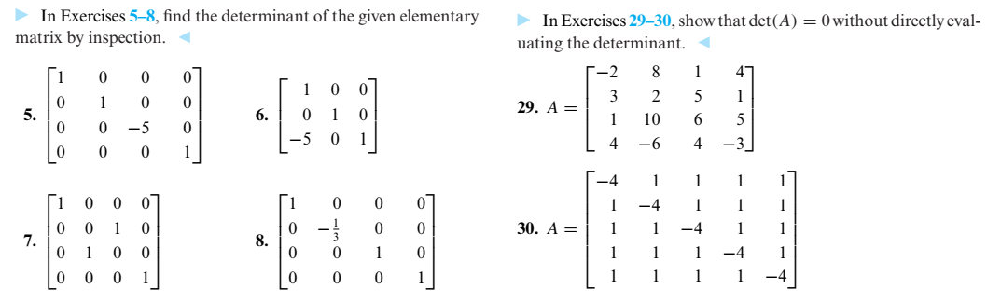
Exercises Set 2.2:

Slide 27
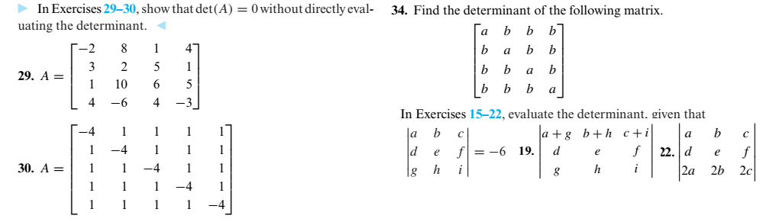
Exercise 2.2 (Contd.)

Slide 28
PROPERTIES OF DETERMINNATS

Slide 29
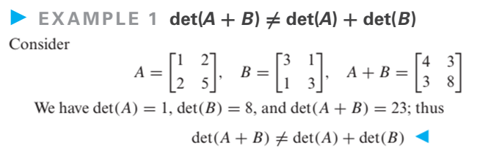
PROPERTIES OF DETERMINNATS

Slide 30
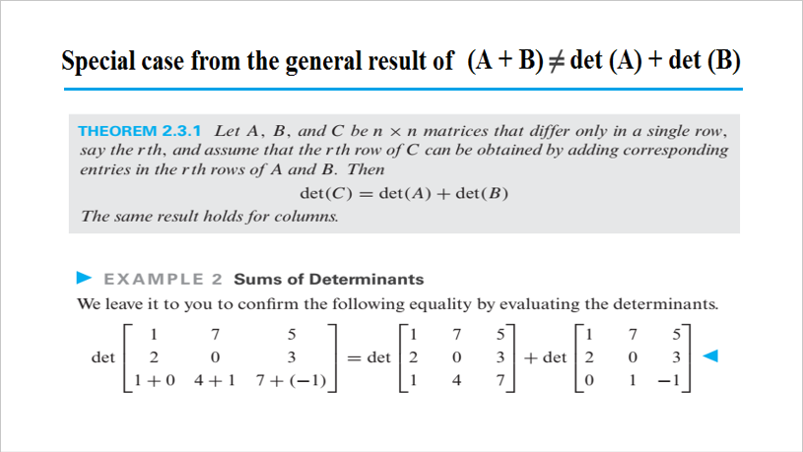

Slide 31
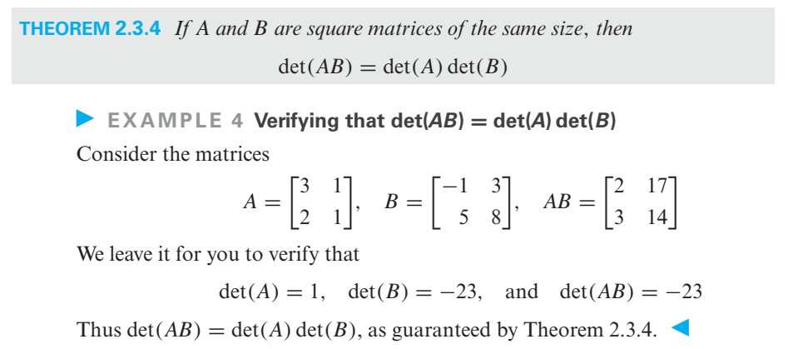
Determinant of a Matrix Product

Slide 32
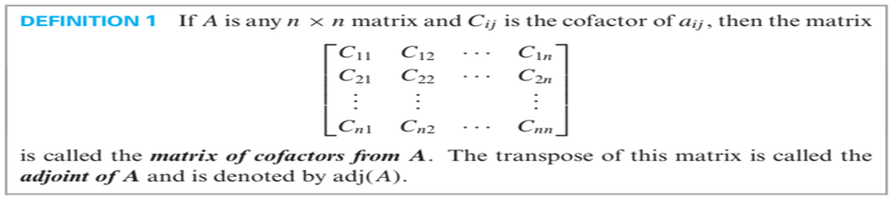
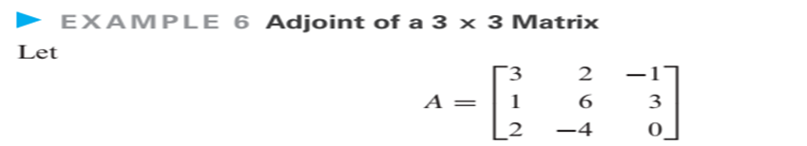
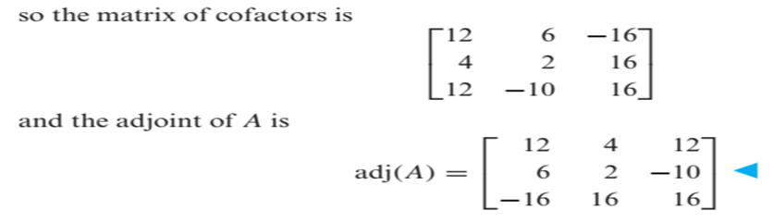
Adjoint of a Matrix

Slide 33
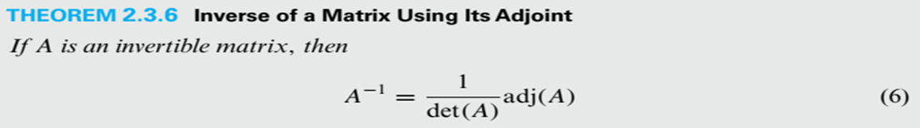
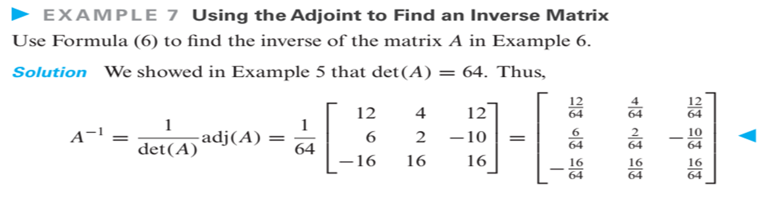
Inverse of a Matrix Using its Adjoint

Slide 34
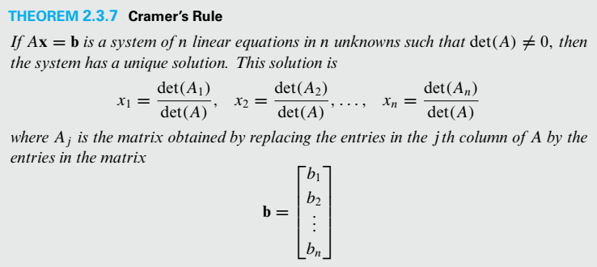
CRAMER’S RULE

Slide 35
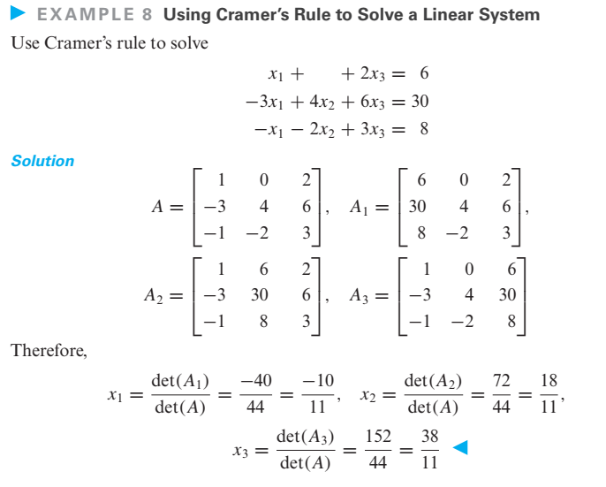

Slide 36
